Slide 1
Scoring Clinic
Notes:
Welcome to the scoring clinic for USAV Volleyball. In this clinic, you will learn all you need to know about keeping score for an USAV match. You will need to print a copy of the USAV score sheet so you can follow along during this presentation.

Slide 2
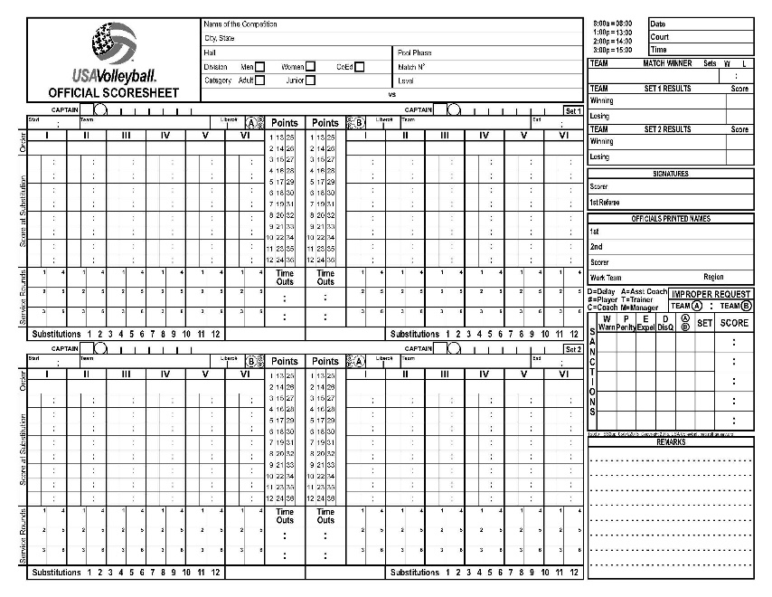
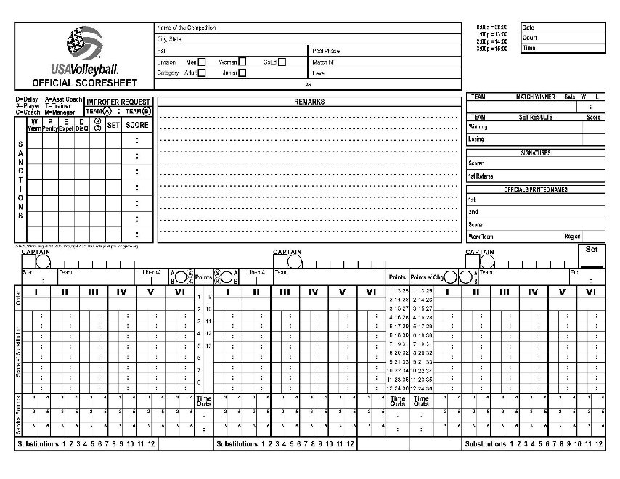
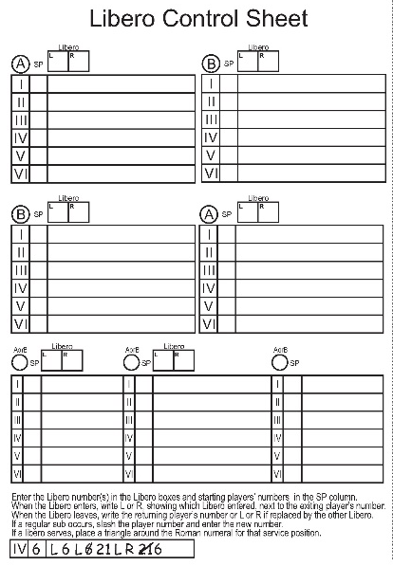
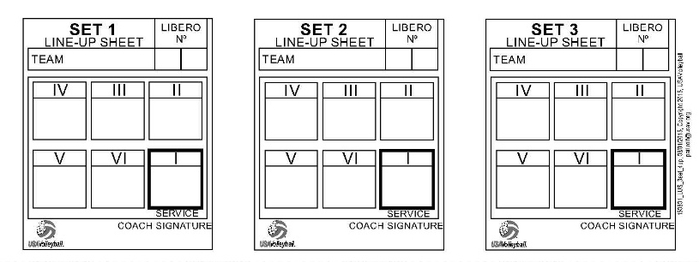
Non-Deciding Set Score Sheet (2 set)
Deciding Set Score Sheet
Line-Up Sheet
Libero Control Sheet
Notes:
On this slide, you can see examples of different sheets that are used for USAV scoring. These include:
•A two set non-deciding set score sheet;
•A deciding set score sheet;
•A Libero control sheet; and
•A lineup sheet.

Slide 3
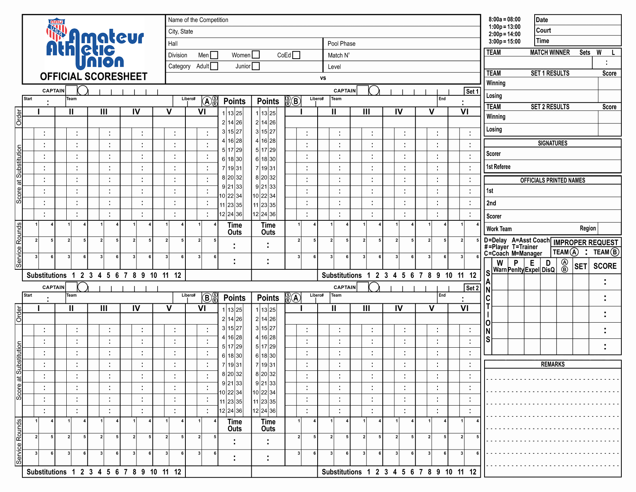
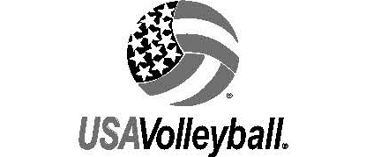
Parts of the Scoresheet
HEADING
(INK)
CAPTAINS
CAPTAINS
TIME AND TEAM(INK)
TIME AND TEAM (INK)
RESULTS
(INK)
SERVICE ORDER (INK)
SERVICE ORDER (INK)
POINTS
COLUMNS
SCORE AT
SUBSTITUTION
SCORE AT
SUBSTITUTION
SIGNATURES
(INK)
OFFICIALS
(INK)
SERVICE ROUNDS
TIME
OUTS
SERVICE ROUNDS
LEGAL SUBSTITUTIONS
SANCTIONS
REMARKS
Notes:
Let’s look at the different parts of the scoresheet you will be using to keep score. During this presentation we will discuss what is contained in each section. Here you can see:
•Heading information;
•Captains information;
•Time and Team information;
•Service Order;
•Service Rounds;
•Score at Substitution;
•Substitutions row; and
•Legal substitution area which is not used in USAV scoring
•Timeouts boxes;
•Points Column;
•Results section;
•Signature sections;
•Officials section;
•Sanctions box;
•Remarks section;

Slide 4
Heading Section
2019 USAV NATIONAL CHAMPIONSHIPS
ORLANDO, FL
ORANGE COUNTY CONV CTR
R1P12
x
2
x
16O
BLUE RED
06/20/19
10
09:00
Notes:
When you first arrive at the score table, you will check to see if the heading section of the scoresheet is already filled out. Many tournaments pre-print the heading information. If not, you want to complete this information in either blue or black pen, making sure that all entries are written in capital letters.
For the match you are keeping score on in this clinic, the name of the competition is 2019 USAV National Championships.
The competition is being held in Orlando, FL, in the Orange County Convention Center.
You are keeping score for Pool R1P12, on match #2. It is important that this information is filled in if available, so there will be accurate posting of match results at the conclusion of the match.
You are keeping score on a women’s junior match so you will place an “X”, not a check mark, in the box next to Women. You then place an “X” in the box next to Junior. The level of play is 16 Open, so you place “16O” in the appropriate space next to the Level. In this match we have Blue vs. Red.
Today’s date is June 20, 2019. Note that there are leading zeros on the month and day if they are single digits. Since the month is June, you see that this is designated as “06” on the sheet. The court number is court 10.
The time which is noted in the heading section is the time the match is scheduled to begin and not the actual start time. The match today is scheduled to start at 9:00 am, and this will be noted in International time of 09:00 which includes a leading zero. If you need a cheat sheet, you will find international time examples at the top of the scoresheet. If this were a 2:00 pm match you would write the time as 14:00.

Slide 5
Officials Section
First referee
  LAST NAME, FIRST NAME
Second referee
  LAST NAME, FIRST NAME
Scorer
  LAST NAME, FIRST NAME
Work team
  PURPLE
Region
  FL
SMITH, JOHN
JONES, MARY
JOHNSON, EMILY
PURPLE
FL
Notes:
Next, still using pen, you will fill in the officials printed name section, again written in all capital letters.
The first referee for the match is John Smith and the second referee is Mary Jones.
You record John’s name as shown here in the first referee section, writing his last name first, followed by a comma and his first name. You will use this same format for all names recorded on the sheet – last name, comma, and first name.
You next fill in Mary’s name in the second referee box.
You see that the scorer’s name, Emily Johnson, is entered in the scorers box.
The work team is the name of the team that is providing the support crew for the match and the region is where that work team is from. You can see that for this match the name of the work team is Purple and they are from the FL region.

Slide 6
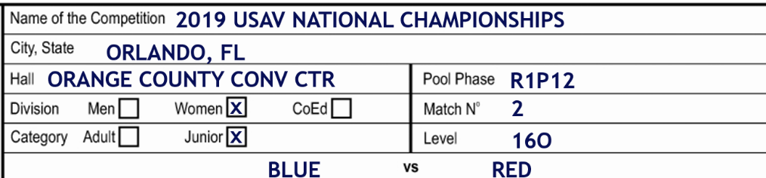
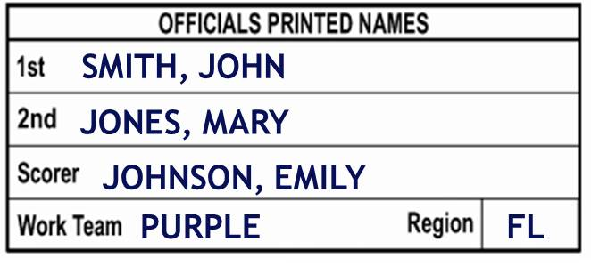
Coin Toss Results
06/20/19
10
09:00
BLUE
x
x
RED
x
Notes:
When the referee gives you the results of the coin toss you use pen to write the team names on the appropriate side of the sheet, again in capital letters. From your viewpoint at the score table, Blue will be serving from the left so their team name will be placed in the team box on the left hand side. <CLICK>The team who starts the match on your left for set one, will be Team A throughout the entire match.
Next, you place an X over the circle “S” to show Blue has the first serve for this set.
Red is occupying the bench on your right for the first set, and are receiving so place their name in the ‘team’ box on the right. They will be team B for the match. And then put an ‘X’ over the R in the circle on the right side of the sheet to show that Red will be receiving the first serve of the set. You also place an “X” in the first service round box under position I for Red. You do this since team B will line up in service order on the court for the start of the set, and will not serve until there is a loss of rally by Blue. When Red receives the ball, they will rotate, and their first server will be the player in position II.
You can see that there are three ‘X’s on the sheet before you have even entered the lineups at the start of every set. Those three X’s are: one placed over the S to denote the team that will serve first, over the R to show team that will receive first, and the X placed in the first service round box of the receiving team.

Slide 7
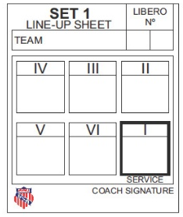
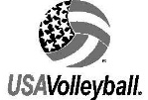
Line-Up Sheets
BLUE
11
X
RED
16
20
47
10c
8
14
1
3
23
2
15
5c
7
9
Bonnie Blue
Reginald Red
No duplicate numbers
There is a “c” next to one of the players numbers
The Libero boxes are not empty
The coach’s signature
Notes:
The teams will give their signed lineup sheets for the first set to either you or the second referee at least two minutes before the end of the last warm-up period. Between sets, the teams must turn their lineups in at least 30 seconds prior to the interval between sets has expired.
When you receive the line-up sheets you will look for the following:
There are no duplicate numbers anywhere on the sheet;
One of the players has a “c” next to his or her number denoting that he or she is the game captain;
There are numbers or an “X” in the Libero boxes; and
The coach has signed the lineup sheet.
If you find duplicate numbers, or one of the other items is missing, ask the second referee to verify the lineup before entering it on the score sheet.
If you receive a lineup sheet that has one or both of the Libero boxes blank, have the second referee verify the Libero information with the coach. If the team will not be using any more Liberos than what are already marked on the lineup, you will place an “X” in one or both boxes to designate there will be one or no Liberos for the set.
Also remember that the teams MUST turn a lineup in for every set. They cannot ask you to use the lineup from a previous set.

Slide 8
X
10
X
5
BLUE
11 X
x
x
16 20
RED
15
8
10
47
23
2
9
3
1
14
5
7
BLUE
11
X
RED
16
20
47
10c
8
x
14
1
3
23
2
15
5c
7
9
Bonnie Blue
Reginald Red
Notes:
Once you have the lineups, and have checked them over, you will enter them on the scoresheet using pen. The player number in the Roman Numeral box I on the lineup sheet is entered into the Roman Numeral column 1 on the scoresheet for that team. It does not matter if a team is serving or receiving, the lineups are always entered onto the scoresheet the same.
For Blue you will enter the lineups like this: 15, 8, 10, 47, 23, and 2. You will then record the numbers 11 and X in the Libero boxes on Blue side of the scoresheet. Number 10 is designated as the game captain, so that number will be written in the circle of the Captain section. USAV does not use roster captains, so the square in the Captain section will always have an “X.”
Once you have finished entering the lineup for Blue, you will enter Red lineup in the same manner, 9, 3, 1, 14, 5, and 7. In the Blue Libero boxes, you will enter 16 and 20. The captain in the circle will be 5, and you will enter an “X” in the square.

Slide 9
X
10
X
5
09 05
BLUE
11 X
x
x
16 20
RED
15
8
10
47
23
2
9
3
1
14
5
7
x
Notes:
During the match, it is also important that you work closely with the second referee. Before the set begins, it is a good idea that the second referee checks the scoresheet to see that the lineups have been entered correctly. He or she will then take the lineup sheets for both teams and check the rotations on the court. At the same time, you check the team lineups of both teams, working with the second referee to ensure that all players are in the correct position on the court for the start of the set. If you see a player on the court you think might be in the wrong position, bring it to the attention of the second referee when he or she places the lineup sheets back on the score table.
When the first referee whistles for the first serve of the set, you enter the starting time for the set using pen. You can see that the first referee whistled for the first serve at 9:05 am, so you write 09:05 on the scoresheet, since all times are written using International time.

Slide 10
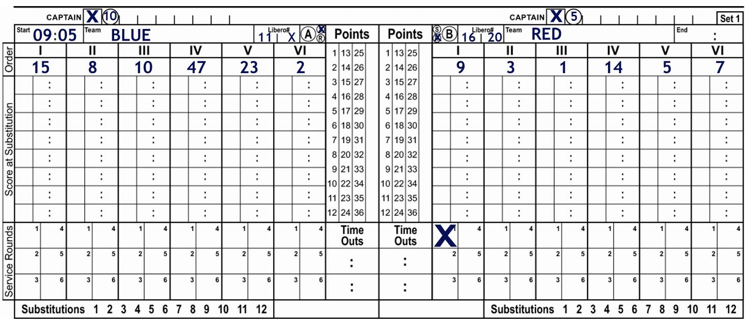
1
Blue #15 serves and scores a point
Blue #15 serves ball out of bounds
Enter exit score
Slash point for Red
Notes:
If you are using pencil to keep score, you can start using pencil after recording the start time of the match.
Blue #15 serves to start the match. When she serves the ball, you will place a small check mark on the one in the first service round box.
Blue wins the first rally of the set, so you will slash point 1 in Blue points column.
Blue #15 serves again. There is nothing to be done on the scoresheet since the check is already in the first service round box for #15, but you must visually check that the correct player contacts the ball for service.
The served ball went out of bounds, so #15’s term of service is over. You need to enter the exit score of Blue in the checked service round box under player #15. The exit score is the total number of points in the points column for that team at the end of a term of service.
You will see the first referee award the ball and a point to Red, so you will slash the next point in the points column for Red, in this case, point 1.
The score is now Blue 1, Red 1.
10

Slide 11
Things to Remember
When not to ü the number in service round box:
  Wrong server contacts the ball for service
    Notify second referee AFTER wrong server has contacted the ball
    Enter exit score
  The team loses the serve without contacting the ball for service
    Enter exit score
  If the last point of the set is scored on a side out
    Enter set point as exit score for next server
Notes:
Let’s talk about some things that you will need to know while keeping score. There are a number of instances where you will not check the number in the service round box.
<CLICK>If the wrong server contacts the ball for service, you will not place a check on the number in the service round box. This is why it is important that you look at the player every time the ball is contacted for service. You must know when it is a wrong server. <CLICK>When it does occur, you will notify the second referee AFTER the ball has been contacted for service. The referee may let the play continue, or she might immediately whistle and signal out of rotation. She may also look at the scoresheet to confirm the player is the wrong server. <CLICK> While the second referee is putting the players in the correct order, you will enter the exit score in the correct service round box of the player who SHOULD have contacted the ball for service.
<CLICK>Another example of when you will not check the service rounds box is when a team loses the ball without contacting the ball for service. This can happen when a server does not contact the ball in the time allowed by the rules, which is 8 seconds for players 15 and older, and 5 seconds for 14 and under. <CLICK>If the player does not contact the ball, simply enter the exit score in that player’s service round box.
<CLICK>
The third example of when you will not check the service rounds box is when the last point of the set is scored on a side out. In other words, the team who receives the served ball, wins the rally, and the set. <CLICK>In this instance, you will only enter the set point as the exit score for the server who would have served next for the winning team.
As you look on the scoresheet, you will see service round boxes under each position for serve, numbered from one to eight. For the first rotation of serve for each position, you will check boxes with the number 1 in the service round section. For the second rotation of serve check boxes with the number 2 and so forth.

Slide 12
1
3
Red #3 serves an ace
#3 serves again and Red wins ensuing rally
#3 commits a foot fault
Enter exit score of 3 for Red
Slash point for Blue
Notes:
Let’s go back to the set you are currently keeping score on. If you remember, the score is currently 1 to 1. Serving next will be #3 for the Red. As the player goes back to serve, you see that it is #3, the correct server, so when she contacts the ball for serve you check the first service rounds box under her position as shown on this slide.
Her serve is an ace, so you slash point 2 in the points column for Red.
As Red #3 serves again, you only need to be sure that the correct server contacts the ball, there is nothing to do on the scoresheet. When the rally ends in a point for Red, you slash point 3 in the points column.
Red #3 commits a foot fault on her next serve, so her term of service is over. You enter the exit score of 3 in the checked service round box since the team has a total of 3 points.
You now slash the next point for Blue in their points column since they were awarded the ball and a point by the first referee.
12

Slide 13
1
3
Blue Libero #11 replaces #8
Libero #11 contacts the ball for service
Draw a triangle around the Roman Numeral and check mark the service rounds box.
Notes:
When Blue rotates, Libero #11 replaces #8 into position 1 to serve the ball. It is legal if a team has designated more than one Libero for both Liberos to serve but only in one position in the rotation. Once a Libero has served in the set, it is illegal for either Libero to serve in another position for that set. They will be able to serve in a different position in subsequent sets of the match.
Since the Libero can only enter the game through replacements, not through substitution, and is not noted on the lineups or on the scoresheet, you will mark things differently when a Libero serves. When #11 contacts the ball for service, you still check the service round box under the correct position, which is Roman Numeral II, the rotation in which #8 is the regular player, and you will also draw a triangle around the roman numeral II in the service order. The triangle denotes the only position in which the Libero for Blue may serve for the remainder of this set.

Slide 14
1
5
3
Blue Libero #11 serves and scores a point
Triangle point 3 in the points column
Triangle points 4 and 5
Enter Blue exit score and slash point for Red
Notes:
When Blue rotates, the Libero replaces player #8 and goes back to serve. When the Libero serves, in addition to checking the service round box, you will place a small triangle on the Roman Numeral in the service order where the Libero served. If the ensuing rally results in a point for the Libero’s team, the point in the points column will not be slashed. Instead, a triangle is used around the correct point. Since Libero #11s serve results in a point, you will triangle point 3 in Blue points column as noted on this slide.
Blue #11 serves for two more points, so triangle points 4 and 5 in the points column for Blue.
She then serves the ball into the net so you will enter the exit score of 5 in the checked service round box for Blue #8, and then slash the next point for Red in their points column.

Slide 15
1
5
3
Red #1 serves
Red score a point
Red #1 serves 3 more points
Notes:
As Red #1 goes back to serve the ball, you make sure that she is the correct server. You see that she is as she serves the ball, so you check the first service rounds box for #1.
Red score a point on the ensuing rally, so you slash point 5 in the Red points column. Red #5 then serves for three more points. At the end of each rally, you slash points 6, 7, and 8 for Red.
The score is now Red 8, Blue, 5.

Slide 16
1
5
3
9
5 8
Blue calls a time-out
Enter the time-out score
Red #1 serves for a point
Red #1 serves and the ball lands “out”
3
Notes:
Before the first referee whistles for the next serve, the coach for Blue requests a timeout. You enter the score for each team in the first timeout box on the Blue side of the sheet. Since the Blue requested the timeout their score is written first, followed by Red score. As you can see, you write 5 to the left of the colon, and 8 to the right of the colon.
Remember that whenever a team causes or requests an action, their score will be recorded first in the correct location. For timeouts, you can see that each team is allowed two timeouts for each set, since there are only two boxes for each team on the scoresheet.
After you have recorded the scores in the timeout box, you will visually show the referees how many timeouts each team has taken. To do this, hold up your hands with the right hand showing how many timeouts have been used by the team to your right side and the left hand showing how many timeouts have been used by the team on your left. In this instance, since Blue took the timeout and they are on your left, you will hold up your hands, with the pointer finger on your left hand extended, and your right hand closed in a fist.
During each timeout you want to check that the visual score is correct, the number of substitutions matches the total team substitutions and the score at change entries for those substitutions are recorded correctly. The second referee will also check the scoresheet, or ask you if everything looks good.
After the timeout is over, the teams return to the court, and you will give the ready signal to the referees by holding your arms straight up with palms facing out.. When the server goes back to serve, you check to make sure it is still Red #1, and when you see it is, there is nothing to be done on the scoresheet since she had already served before the timeout. She serves for a point, so you slash point 9 for the Red.
Red #1 then serves the ball out of bounds, so you enter the Exit Score of 9 in the checked service round box. Then you slash the next point, #6, in Blue points column.
16

Slide 17
1
5
3
9
5 8
Blue #10 serves
Blue scores a point
Blue score another point
Notes:
You watch as Blue #10 serves the ball and see that she is the correct server, so you check the first service rounds box under her position. Blue scores a point on her serve, so you slash point 7 in Blue points column.
#10 serves again and Blue scores another point, so you slash point 8 in Blue points column.
The score is now Blue 8, Red 9
17

Slide 18
2
9 8
1
5
3
9
5 8
Red requests a substitution
Record the number of entering player
Record the team scores
Slash the Substitution row
Show the ready signal
Notes:
Before the first referee beckons for the next serve, Red #2 enters the substitution zone. The second referee whistles the request, and you see that #2 is substituting into the game for #1. You will enter the #2 in the score at substitution section in the first box beneath #1 to the left side.
You then enter the score for each team on the right side of the box, listing Red score of “9” to the left side of the colon since they are the team making the substitution, and then write Blue score of “8” to the right of the colon.
Then slash the next number in the substitutions row. Since this is the first substitution Red has made in this set, you are slashing the #1.
When you have recorded all information on the sheet for the substitution, give the ready signal.
18

Slide 19
Substitution Rules
12 substitutions per team per set
  No limit to number of individual entries
  Inform second referee when a team has taken their 9th, 10th, 11th, and 12th substitution
May only play in one position in the rotation
  No limit on number of players
  Exceptional substitution
Notes:
Here are some substitution rules that you need to know as you keep score.
Each team is allowed 12 substitutions for each set with no limit to the number of times a player may enter the court as a substitute. You want to make sure you inform the second referee when a team has taken their 9th, 10th, 11th, and 12th substitutions. Of course, if the second referee asks you to notify him or her sooner, you will also accommodate that request.
Once a player has entered the game in one position in the rotation, that is the only position he or she may enter for the remainder of the set. And there is no limit to the number of players who may play in one position of the rotation. But once someone plays in that position, that player is locked into that position.
The only time there is an exception to this is if there is an exceptional substitution. An exceptional substitution would occur if a player is injured and unable to play. If this occurs, the second referee will assist you in noting this on the scoresheet.

Slide 20
2 9 8
1
5
10
3
9
5 8
Blue serves 2 points
Blue serves into the net
Red serves and wins a point
Red wins 3 more points
Notes:
Let’s go back to the set you are currently keeping score on. Looking at the sheet, we know the score is Blue – 8, Red – 9, and we can see that the current server is Blue #10.
#10 serves for two more points for Blue so you slash points 9 and 10 in the points column, and then #10 serves the ball into the net. You enter the exit score of 10 in the checked service round box, and slash point 10 for Red in their points column.
The correct server for Red, #14 serves the ball so you check the first service round box under her position, and Red wins the ensuing rally so you slash the next point, #11, in their points column.
Red #14 serves three more times, and Red wins a point on each of those three serves. You slash the numbers 12, 13, and 14 in the points column for Red.
The score is now Red 14; Blue 10.
20

Slide 21
14 10 14
2 9 8
1
5
10
3
9
15
5 8
10 14
Blue requests a substitution
Record the number of entering player and score
Slash the substitution row
Give the ready signal
Red serves and scores the point
Blue wins the rally
Notes:
Before the first referee beckons for the next serve, Blue #14 enters the substitution zone and the second referee whistles the request. You see #14 substitute into the game for #47. You enter 14 in the score at substitution section in the first box beneath 47. You then enter the score for each team, listing Blue’s score of “10” to the left side of the colon and Red’s score of “14” on the right.
Slash the “1” in the substitutions row for Blue, and once you have completed recording all the information, give the ready signal to the referees.
You make sure that the correct server, Red #14 contacts the next serve and when the rally results in a point for Red, you slash point 15 in the points column. Red #14 serves again, but the rally is won by Blue, so you enter the exit score of 15 in the checked service round box for Red 14, and slash the next point for Blue in their points column.
The score is now Blue 11; Red 15.
21

Slide 22
14 10 14
2 9 8
1
5
10
15
3
9
15
5 8
Blue #14 serves
Blue wins the point
Blue serves 3 more points
Red wins the rally
Notes:
Blue #14 contacts the ball for service and since you checked to make sure she was the correct server, you check the first service rounds box. When Blue wins the ensuing rally, you slash point 12 for Blue.
Blue 14 serves for three more points, and at the end of each rally, you slash the correct points in the points column for Blue.
#14 serves the ball one more time, and Red wins the rally that follows. You enter the exit score of 15 for Blue in the checked service round box and slash point 16 in the points column for Red.
22

Slide 23
14 10 14
2 9 8
1
5
10
15
3
9
15
16
5 8
Red #7 contacts the ball for service
Wrong server
Exit score entered; no check mark
Notes:
As Red #7 goes back to serve, you look at the scoresheet and see that #5 should be serving next. As she contacts the ball for service, you double check the sheet to make sure that you are correct, and when you see that you are, you tell the second referee that the <CLICK> wrong player has contacted the ball for service.
Since the correct player did not contact the ball for service, <CLICK>you do not put a check mark in the service round box, you just enter the exit score of 16 in the service round box for the player who SHOULD have contacted the ball for service.
You will then slash the next point, 16, for Blue in their points column. There is no other information needed on the scoresheet for a wrong server.
The score is now tied at 16.
23

Slide 24
14 10 14
2 9 8
47 16 21
1
5
10
15
16
3
9
15
16
22
5 8
Blue #23 serves the ball, Red wins the rally
Red #7 serves the ball for a point
#7 serves for 3 more points for Red
Blue #47 substitutes for #14
Red #7 serves for another point
#7 serves the ball, and Blue wins the rally
Notes:
As Blue #23 serves the ball you first check to make sure she is the correct server, and when you see that she is, you check the first service rounds box. At the end of the rally, which is won by Red, you first enter the exit score of 16 in the checked service rounds box, and then slash the “17” in Red points column.
#7, the correct server for Red, contacts the ball for serve so you check the first service rounds box under her position. The ensuing rally is won by Red, so you slash point 18 in Red points column. #7 serves for 3 more points, and at the end of each rally, you slash the next point in Red points column.
After Red score point 21, Blue #47 enters the substitution zone, and the second referee whistles the request. You see that #47 enters the game for #14, a legal substitution since it is the same position that #47 has already been in, You will enter the #47 in the score at change section in the first box beneath #14 to the left side. You then enter the score for each team on the right side of the box, listing Blue score of “16” to the left side of the colon since they are the team making the substitution, and then write Red score of “21” to the right of the colon.
Then you slash the 2 in the substitutions section for Blue – showing that this is their second substitution. After you have recorded all the information, give the ready signal to the referees.
Red #7 serves for one more point, so you slash the next point, 22, in the Red points column. #7 serves again and Blue win the subsequent rally so you enter the exit score of 22 in the checked service rounds box, and slash point 17 in the Blue points column.
24

Slide 25
14 10 14
2 9 8
47 16 21
1
5
10
15
16
3
9
15
16
22
5 8
22 19
Blue #2 serves and wins the point
Blue serves again and wins point 19
Red is granted a timeout
Notes:
As #2 goes back to serve the ball, you make sure she is the correct server, and then check the first service round box under her position when she contacts the ball. Blue win the rally, so you slash the next point, 18, in the points column for Blue. #2 serves again and Blue wins point 19.
Before the first referee whistles for the next serve, Red calls for a timeout. In Red’s first timeout box, you enter Red’s score of 22 on the left and Blue’s score of 19 on the right. You then let the referees know that each team has taken 1 timeout by holding up your pointer finger on each hand.
25

Slide 26
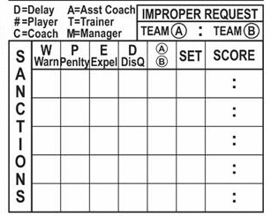
14 10 14
2 9 8
47 16 21
1
5
10
15
16
3
9
15
16
22
5 8
22 19
Red #14 is assessed a red card
Record penalty in Sanctions Box
Slash and circle penalty point
for Blue
14
B
1
22 19
Notes:
As the teams are returning to the court after the timeout, the first referee assesses Red #14 a red card due to unsporting conduct. You will record the information about the individual sanction in the sanctions box on the scoresheet.
Since a red card was shown, indicating a penalty on the player, you first write the player’s number in the P, or Penalty box. Next you will indicate that #14 plays for Team B, by placing a B in the box under A or B, and the number 1 in the set box since this is the first set. The Score at the time the penalty is assessed is 22 to 19 – and since the penalty is against a Red player, you will write Red’s score first. When a penalty is assessed, the opponent wins the serve and a point, so you slash the next point in Blue points column, 20, and then circle that number to show it was earned on a penalty by the opposing team.
After you have recorded all the information pertaining to the penalty, give the ready signal to the referees.
26

Slide 27
Sanctions
Sanctions are for the match
Warning – no further penalty
Penalty – point and ball awarded to opponent
Expulsion and Disqualification – no further penalty
x
D
A
1
0 0
10
B
1
3 2
D
A
1
7 17
C
B
1
18 10
3
B
2
8 4
Notes:
Here are some basic tips to remember about sanctions:
All sanctions are in force for the match so you must note all sanctions on subsequent scoresheets for the match.
When a warning is given, there is no further penalty, but the warnings are recorded on the score sheet.
When a penalty, or red card, is assessed, whether it is individual or team, the opponent will receive the serve and a point.
For an expulsion, which is a red and yellow card together, and a disqualification, a red and yellow card apart, there is no other penalty. You will record the sanction on the scoresheet, but the opponent will not receive a point.
When the referees inform you of any sanctions during the match, you will note them in the sanctions box as shown here.
In this example,
Team A received both a delay warning and delay penalty in the first set,
Team B #10 received an individual warning
Team B received an improper request,
Team B coach was expelled
Team B #3 was disqualified in the second set.

Slide 28
14 10 14
2 9 8
47 16 21
1
5
10
15
16
20
3
9
15
16
22
22
5 8
22 19
23
Blue #2 serves; Red wins the rally
Red # 9 serves; check service round box #2
Blue wins the rally
Blue #15 serves, and Blue wins the point
Blue serves out of bounds
Notes:
Going back to the current set, remember that Blue #2 was serving before Red called a timeout and a sanction was assessed to a Red player. You see that #2 is still the correct server, and watch as she contacts the ball for service. Red wins the subsequent rally, so you enter the exit score in the checked service round box, and slash the next point, 23, in Red points column.
You check to make sure that Red #9 is the correct server as she goes back to serve the ball. Since there is now either a check and a score, or an X in all first service round boxes, you make the check in the second service round box, which is directly below the first service round box for all players. Blue wins the rally, so you enter the exit score for Red in the checked service round box, and slash the next point, 21, for Blue.
The correct server for Blue #15 serves the ball, so you check the second service order box under her position, and Blue win the subsequent rally, so you slash point 22 in Blue points column.
#2’s second serve goes long, so you enter the exit score of 22 in the checked service round box under #2, and you slash point 24 in Red points column.
The score is now Blue 22, Red 24.
28

Slide 29
14 10 14
2 9 8
47 16 21
1
5
10
15
16
20
3
9
15
16
22
22
23
5 8
22 19
23
24
25
Red #3 serves, and Blue wins the point
Blue Libero #11 goes back to serve
Red wins the point
Enter 25th point with no check
Notes:
As Red #3 goes back to serve, you look to make sure she is the correct server. When she contacts the ball for service, you check the second service rounds box under her position. When the served ball goes into the net, and the first referee awards the ball to Blue, you enter the exit score of 24 in the checked service round box and slash the 23rd point in the Blue points column.
You see that Blue Libero #11 is going back to the service position, so you look at the scoresheet to see if this is the correct position for a Libero to serve. Since there is a triangle around the Roman Numeral for this position, it is the legal position for #11 to serve.
Libero #11 serves the ball, and after a long rally, Red wins the point. You record the exit score of 23 in the checked service round box, and slash point 25 in Red points column.
Since Red won the set on a serve by the opponent, no check mark is entered in the next service rounds box for Red #1. You only enter the exit score of 25 in that box.
Red wins the first set of the match, 25 to 23.
29

Slide 30
09 27
14 10 14
2 9 8
47 16 21
1
5
10
15
16
20
3
9
15
16
22
22
23
5 8
22 19
23
24
25
Record end of set time
Circle final exit scores
T-bar unused points in points column
Notes:
After you put in the number 25 in the service round box, you check your watch and see that it is 9:27 am. If you used a pencil to keep score, you will now switch back to pen and enter the end time of the set in the end box using International time of 09:27.
You then circle the last exit score for each team in the service round box. For Red this would be 25 and for Blue it is 23.
You then draw a T-bar through the unused points in the points column for each team. This is done by drawing a horizontal line under the last point scored for each team and drawing vertical lines through all of the unused points.
30

Slide 31
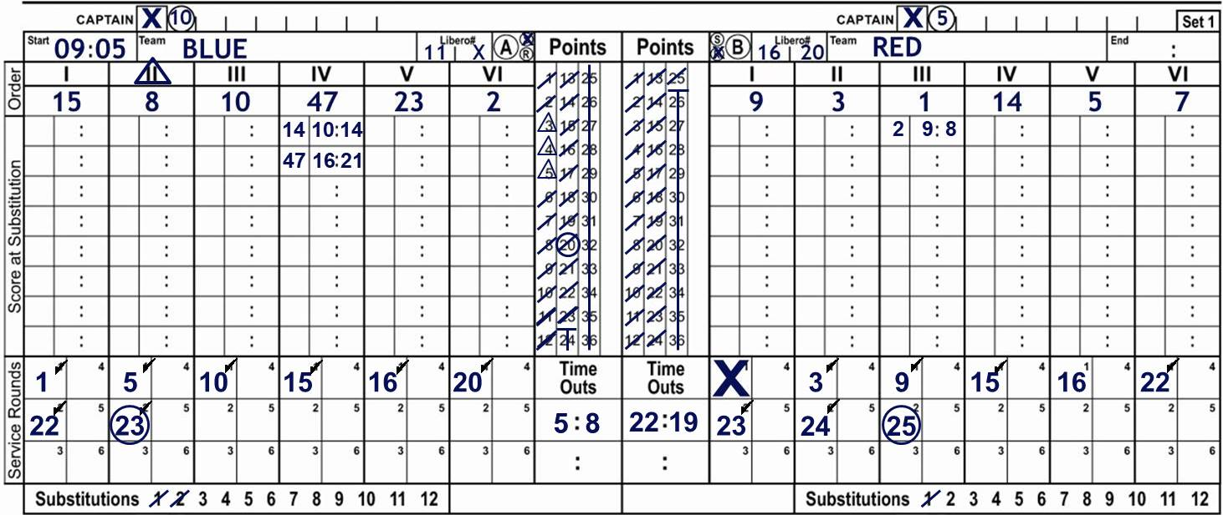
06/20/19
10
09:00
RED 2 1
RED 25
10 13
BLUE 23
09 27
BLUE 25
RED 21
Emily Johnson
John Smith
14
B
1
22
19
Enter winning and losing teams and scores
Check over the scoresheet
Enter second set results
At end of match, fill in match results
Sign your name
First referee signs last
Notes:
You will then enter the winning team and their score – which is Red with a score of 25, followed by the losing team, Blue, and their score of 23 in the results section of the scoresheet.
You should check over the scoresheet to make sure it is complete, and that you have properly recorded the winning and losing teams.
At the end of the second set of the match enter those scores also.
At the completion of the match you will enter the match winner and the set results. Red won this match 2 sets to 1 set. When you feel that all is correct, you will sign your name on the sheet.
The last step will be to have the first referee sign the sheet, after he or she checks it over to ensure all is correct.
Congratulations!!! You have successfully completed keeping score for this set!
31

Slide 32
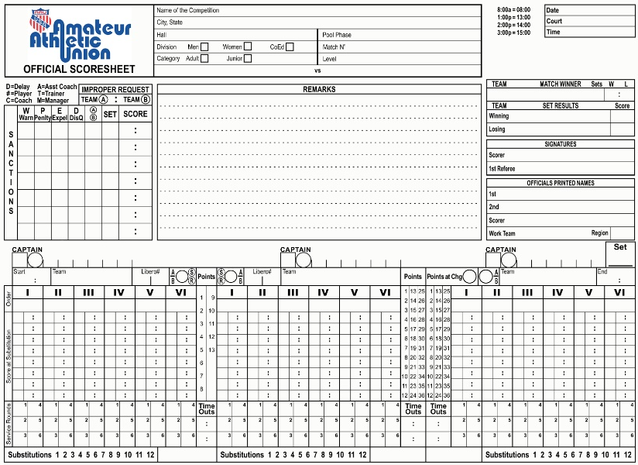

Deciding Set
06/20/19
10
09:00
14 B 1 22 19
3
Notes:
Let’s take a look at some other aspects of keeping score.
As you saw at the beginning of the clinic, a different scoresheet will be used any time a match goes to a deciding set. For the most part you will keep score exactly as you did on the regular scoresheet, with a few exceptions that we will cover on the next few slides.
The heading section will be exactly as it was for the first sets of the match.
It is important to transfer over any sanctions or remarks that are noted on other sheets used in this match, since sanctions carry through for the entire match. You also want to make sure the officials section is filled out, and that you record the set number in the appropriate box below the officials section.

Slide 33
Deciding Set
06/20/19
10
09:00
14 B 1 22 19
3
B
X
RED
X
A
BLUE
B
RED
X
Notes:
After the coin toss, the referee informs you that Red is going to occupy the bench to your left to start the set and that Blue will be serving from your right.
You will write Red in both team boxes on the left and right sides of the scoresheet, and also put the letter B in the appropriate circles since Red is Team B in this match.
You then write Blue in the team box in the middle section of the sheet, note they are Team A.
Then “X” the R denoting that Red will receive serve, and “X” the S, showing that Blue will serve first in the deciding set.
And remember to write the third “X” in the first round service box under position 1 for Red since they are not serving to start the set.
33

Slide 34
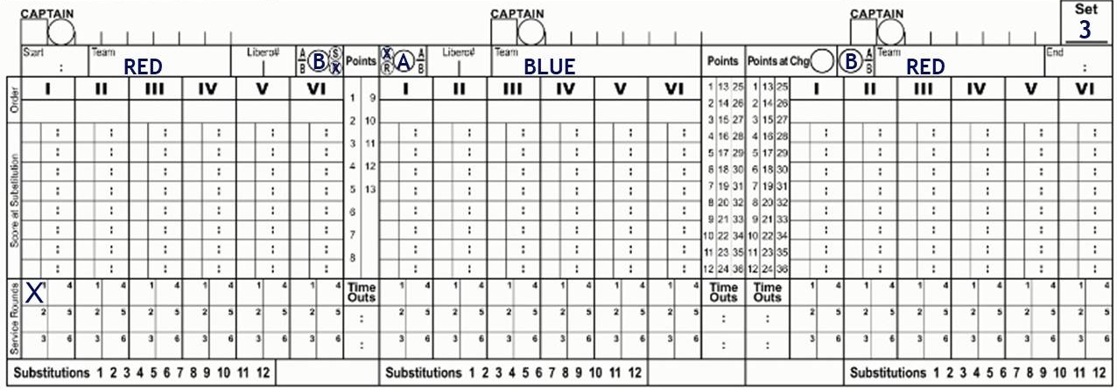
Deciding Set
X
5
X
10
X
5
16 20
11 X
9 3 1 14 5 7
15 8 10 47 23 2
9 3 1 14 5 7
Notes:
When you receive the lineups, enter Red’s lineup in the lineup section on both the left and right sides of the sheet, including the Liberos and the captain.
You then enter the lineup for Blue in the middle section of the score sheet, including the Libero and captain.
34

Slide 35
Deciding Set
X
5
2
X
10
X
5
2
09 54
16 20
11 X
9 3 1 14 5 7
15 8 10 47 23 2
9 3 1 14 5 7
2
7
2 4
2
0 0
0 0
4
5
4
5
7
0 4
0 4
Notes:
Since you have already learned how to keep score already, let’s move ahead to the time when there are differences in keeping score on the deciding set sheet. You are in the middle of the third set between Blue and Red.
You will notice that you are keeping score as normal with Red on the left and Blue on the right. The score is currently 7 to 7 and you can see that at 0-0, Red substituted #2 in for the captain, #5. This substitution was noted on both the left and right sides of the sheet, in the score at substitution section, and in the total substitution box, where the “1” was slashed to show it was the teams first substitution in this set.
Since #5 was the captain, the second referee asked the coach who the new playing captain will be. When the second referee told you that #2 is the playing captain, you entered this number in the Captain’s section on both the left and right sides.
You also noted the timeout by Red, which occurred at 0 to 4, in the appropriate box on both the left and right sides.
And of course, Blue’s substitution was noted only in the middle section of the scoresheet.

Slide 36
Deciding Set
X
5
2
X
10
X
5
2
09 54
16 20
11 X
8
9 3 1 14 5 7
15 8 10 47 23 2
9 3 1 14 5 7
2
7
2 4
2
0 0
0 0
4
5
4
5
7
5
0 4
0 4
Notes:
There are a couple of scenarios of what you will record at the 8th point, depending on which team reaches 8 first.
In this first scenario, #14 serves the ball, and Red wins the rally. You will first slash the 8th point in Red’s point column, and then record Red’s score of 8 in the Points at Change circle next to their team name in the right section.
You will also slash point 8 in Red’s Points Column on the right side.
You will not enter an exit score in the checked service round box on the left side of the sheet since #14 will continue to serve after the court switch.
You will then transfer the LAST exit score from the left to the right side of the sheet, but NOT the corresponding check mark.
36

Slide 37
Deciding Set
X
5
2
X
10
X
5
2
09 54
16 20
11 X
7
9 3 1 14 5 7
15 8 10 47 23 2
9 3 1 14 5 7
2
7
2 4
2
0 0
0 0
4
5
7
4
5
7
7
0 4
0 4
Notes:
Let’s take a look at the second scenario. It is still 7 to 7 and Red #14 contacts the ball for serve. Blue wins the rally, giving them point 8.
You first record the exit score of 7 in the checked service round box and slash point 8 in Blue’s points column.
You then record the score of 7 in the Points at Change circle next to Red’s team name in the right section of the sheet and slash point 7 in Red’s points column on the right.
Finally, you will transfer Red’s last Service Rounds exit score from the left to the right section, but again, do not transfer the corresponding check mark. You can see that the next time Red serves, #2 will be their correct server.
37

Slide 38
Deciding Set
X
5
2
X
10
X
5
2
09 54
16 20
11 X
7
10 10
9 3 1 14 5 7
15 8 10 47 23 2
9 3 1 14 5 7
2
7
2 4
2
0 0
0 0
4
5
7
4
5
7
9
12
13
7
8
10
0 4
15
0 4
11
Notes:
At the end of the deciding set, you will complete the scoresheet as you did the previous sheet by circling the final exit scores and placing a T-bar over the remaining points in only the right two points columns. You will not T-bar any unused points on the left.
You complete the results section just as you would for any other set, making sure you have the correct team winning the match, that you sign the sheet after ensuring all is correct, and then the first referee will sign.
38

Slide 39
Scoring Clinic
Notes:
Thank you for viewing the USAV Scoring Clinic! You are ready to keep score for the 2019-2020 season!

